Slide 1
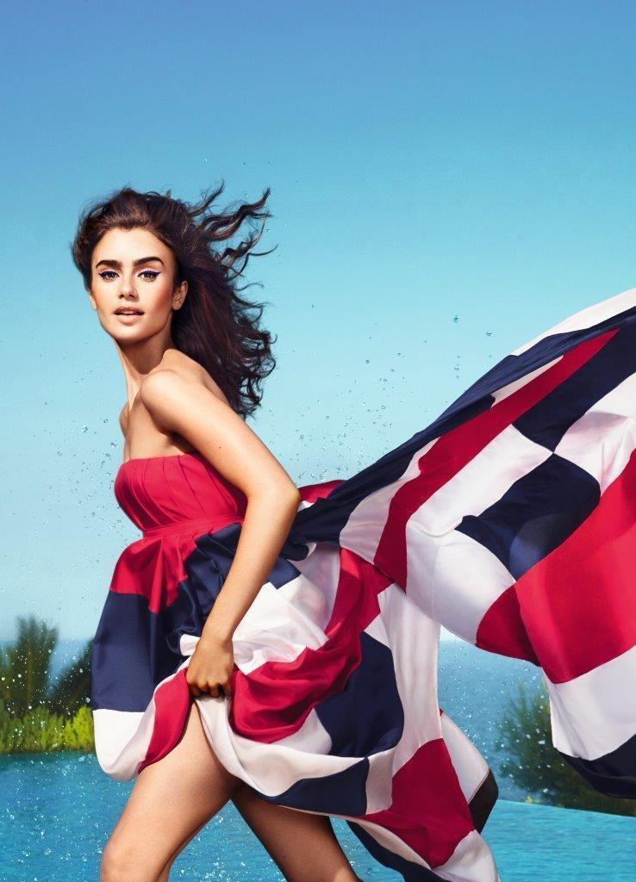
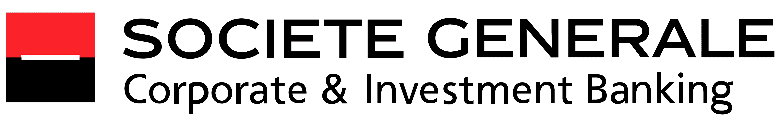
L’Oréal Discussion Materials
19 September 2024

Slide 2
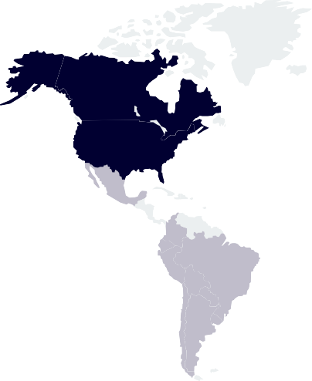
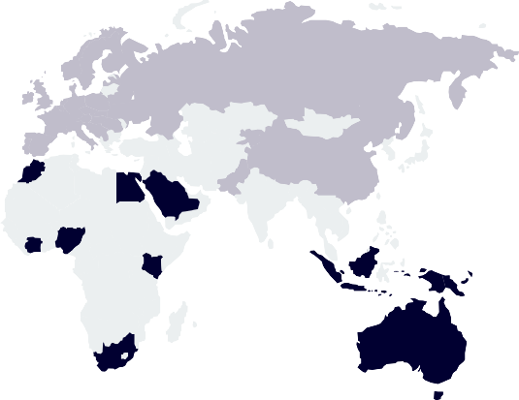

L’Oréal, No.1 Beauty Group worldwide L'Oréal is the global leader in beauty, seamlessly blending innovation and sustainability to create products for every consumer
Company’s Description
Business Overview
L'Oréal was founded in 1909. The company is a global leader in the beauty industry, listed on the CAC40 with a market capitalization of €195,04bn (as of 13/09/2024). The company is headquartered in Clichy, France.
L’Oréal specializes in hair color, skincare, sun protection, makeup, perfume, and hair care. L'Oréal is known for its strong commitment to research and innovation
L'Oréal has made significant sustainability commitments, including a goal to achieve carbon neutrality by 2025
L'Oréal business is structured into four key divisions each focusing on different market segments to meet diverse beauty needs worldwide
L'Oréal Luxe
Professional Products
Consumer Products
Active Cosmetics
+37 Brands
+90k employees
+6.5bn of products sold
Recent Developments
Geographical Footprint
4% of own shares purchased from Nestlé (2021)
Aesop Acquisition
(2023)
10% stake in Galderma Acquisition
(2024)
Europe
31,6%
€13,7 bn
Mugler and Azzaro Acquisition (2020)
`
South America
7,1%
€2,92 bn
North Asia
25,9%
€11,66 bn
North America
27,1%
€11,15 bn
SAPMENA
8,4%
€3,45 bn

Slide 3
L’Oréal – Financial Performance
LTM Share Price Performance (vs. CAC40 index)
2018A – 2023A Historical Financial Performance
Sales Breakdown by Division
Shareholding Structure
€41.18bn

